Slide 1
Beginning Games Development In Python

Slide 2
Python game dev
Development tools
Basic principles of 2d games development
Osmos demo walkthrough

Slide 3
Development tools
IDE – WingIDE
Game development framework (PyGame)

Slide 4
WingIDE
Download from http://wingware.org/downloads
FREE 101 version
FREE Professional version if you provide proof of participation in an Open Source project!

Slide 5
PyGame
Linux:
Sudo pip install pygame
Windows:
Download package from http://www.pygame.org/download.shtml
Install .msi file
Mac:
Download package from http://www.pygame.org/download.shtml
Install .dmg file

Slide 6
Principles
Drawing images (Sprites)
Simulating movement
Collision response
Debugging realtime applications

Slide 7
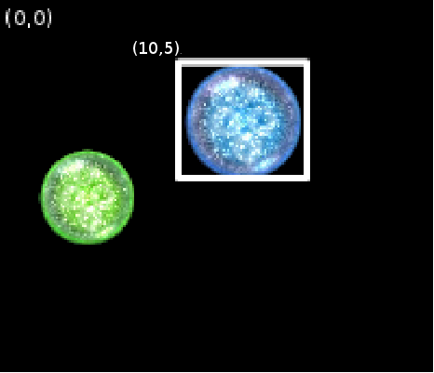
Drawing images
In PyGame images are rectangles starting from the top left corner as the origin and contain a width and height member variable

Slide 8
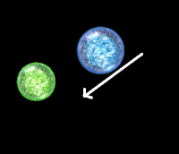
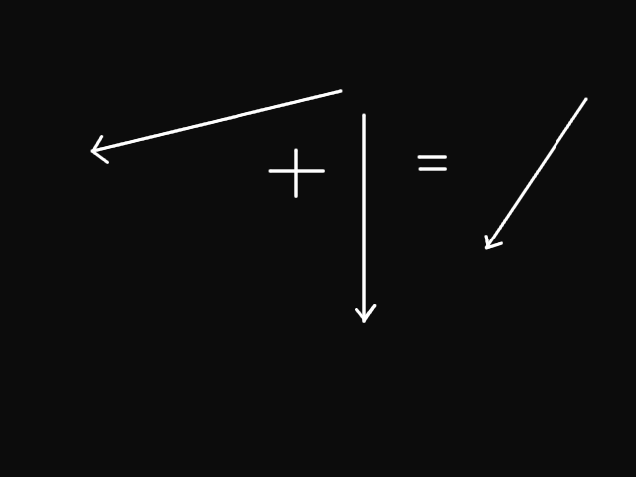
Simulating Movement
Movement is modelled using basic 2d physics
Movement = current position + a velocity over time

Slide 9
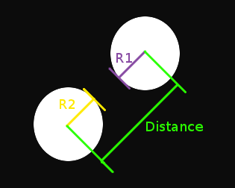
Collision Response
Two Methods: Bounding Box or Bounding Circles
In Bounding Circle a collision occurs when the distance between two circles is less than the sum of thier radii

Slide 10
Debugging Realtime Apps
Use a logger
Output to the console using 'print'
Use your IDE to step through the code!
__repr__() is your freind!

Slide 11
References
Http://www.pygame.org
http://inventwithpython.com/

